Slide 1

Luke Partnership 2019

Slide 2
Planning a Bible translation project
Roles and responsibilities

Slide 3
Overview
Translation projects vary greatly. Each translation project has to be planned according to the particular local situation.
The aim in these discussions is to cover some of the general principles, and to help those who are involved understand the different aspects of the work that need to be considered.

Slide 4
The following notes apply particularly to translation projects in language areas where there are already some churches in the area.
In the discussion, it is assumed that the translators speak the receptor language as their first language.

Slide 5
Teamwork
The task of completing a translation of the Bible into any language is something that no person can do alone.
The task is too big for one person, and it needs many different skills.
The task belongs to the whole church in the language area and there must be
a team of people sharing in the work.

Slide 6
Teamwork
Such a great task can be completed successfully if the whole team works together.
Each member of the team must know his or her role, and must do it faithfully.
Each member of the team must be ready to give time and to work hard.

Slide 7
Who will be needed on the team?
Translation planning committee
Pastors and church leaders
Project coordinator
Translators
Secretary (with computer skills)
Reviewers and testers
Translation consultant (visiting)
Notes:
First show the heading only
Invite participants to suggest the different members of the team that will be needed.
Write suggestions up on the board – discuss what each one might do.
Then view the list. (See more detailed suggestions in the Lesson Plans.)

Slide 8
Teamwork
The translation team are members of the churches and the community.
Everything is done in the context of close cooperation and joint responsibility with the churches and with the local community.
The work can only be successful if it is done prayerfully, with the guidance and empowering of the Holy Spirit.

Slide 9
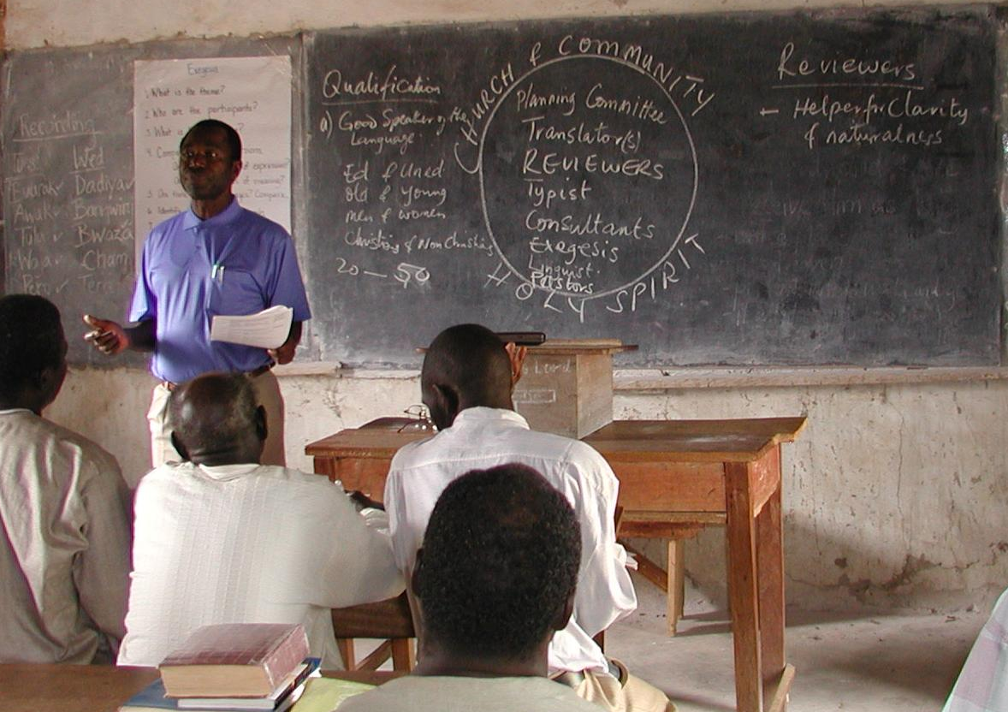
A training session in progress

Slide 10
The next slides explain the responsibilities of the different parts of the team:
The churches and the community
Pastors and church leaders
Translation planning committee
Project coordinator
Translators
Secretary (with computer skills)
Reviewers and testers
Translation consultant (visiting)
Notes:
This is a good place for a break.
Suggest give an assignment to make notes on the anticipated responsibilities of each team member. This will be the basis for discussion in the next session.

Slide 11
The churches & the community
Each translation team needs supporters who will:
(a) Pray regularly for the translators, and for all aspects of the Bible translation project.
(b) Give money to help meet the many expenses that are involved.
(c) Be involved from the beginning in receiving and using the translation.

Slide 12
Pastors and church leaders
Responsibilities
(a) To recognize the value of the mother tongue in communicating effectively and to show a positive attitude toward the use of the language.
(b) To read portions of the translation regularly in church services, prayer meetings and other gatherings, and to use the translation in preaching and teaching.

Slide 13
Pastors and church leaders
Responsibilities continued
(c) To encourage people to use the translation; for example, in Bible study groups, in family devotions, and for personal study;
(d) To encourage people who cannot read to learn to read;
(e) To keep people informed about the translation project.

Slide 14
The translation planning committee
The translation planning committee represents the churches of the area. Representative members are appointed by the different denominations in the area.
This committee does not do the translation, but is responsible for the organisation of the project.

Slide 15
The translation planning committee
Qualifications
Members of the committee must be mature Christians who are themselves convinced of the need for the Scriptures in the local language.
They must be ready to give time to carry out their responsibilities.

Slide 16
The translation planning committee
Responsibilities
(a) To help select and appoint the translators, the reviewers, and others involved in the project.
(b) To keep the churches and community informed about the project.
(c) To encourage people to pray for the translators, for the other members of the translation team, and for all aspects of the project.

Slide 17
The translation planning committee
Responsibilities continued
(d) To be responsible for raising money and for overseeing the finances of the project.
(e) To be responsible for decisions affecting publication, such as the format of the book, and the choice of publisher.
(f) To plan for the distribution and use of the translated Scriptures, both during the time when the translation is being tested, and when the final printed copies are ready.

Slide 18
The project coordinator
A project coordinator is needed, who is responsible for the administration and management of the project, including developing plans and writing reports.
His responsibilities include serving as liaison with the Bible translation organisation to which the project relates.

Slide 19
The project coordinator
He is responsible for making sure that each team member knows his part in the work, and for ensuring that the team have the resources needed for their work.
The project coordinator may also be a translator, but not necessarily so.

Slide 20
The translators
If possible, several translators should be trained.
The ideal is a team of at least three translators.
A translator should have the following qualifications:

Slide 21
The translators - qualifications
Spiritual commitment
He should have a deep conviction that God has called him to be involved in the translation of the Scriptures.
He should have a good knowledge of the Bible and understanding of biblical truths.

Slide 22
The translators - qualifications
Technical ability
(a) He (or she) must speak the receptor language as his first language.
(b) He should be a fluent speaker of the language with ability to express himself well.
(c) If possible, he should know English (or another major language) well enough to enable him to use different translations of the Bible, and reference helps, such as commentaries and Bible dictionaries.

Slide 23
The translators - qualifications
Technical ability continued
(d) If he does not have a good knowledge of English or another major language, then he must know another regional language of wider communication (for example, Hausa, Swahili, Amharic) enough to understand well the text from which he is translating.
(e) He should be able (or ready to learn) to use a computer, and to keyboard and edit the translation, learning to use the Paratext program and other software tools.

Slide 24
The translators - qualifications
Character
(a) He must be humble, willing to listen to advice, and able to receive criticism, seeing himself as a servant of his people.
(b) He must be teachable, willing to improve and develop his knowledge and skills, always expecting that he can learn from others.
(c) He must be persevering; he should live a disciplined life, being able to work steadily and to continue, even when there are discouragements and progress is slow.

Slide 25
Remember – translation is teamwork
Members of the team have different strengths:
One may be the primary exegete, having an excellent knowledge of the Bible.
Another may be gifted in expressing the meaning creatively and in good style.
Another may have the ability to notice details and to edit carefully and well.
The team needs to work together, using the gifts and knowledge God has distributed among them to the full.

Slide 26
The translators - responsibilities
(a) To study the source text and prepare the first draft of the translation.
(b) To keyboard the translation, then to share and team check the translation with other team members, using the Paratext program and/or other software.
(c) To help test the translation with other speakers of the language. (Reviewers and other testers will also assist in this part of the work. See “Reviewers” and “Testers” below.)
Notes:
This is a suitable point to break, if needed.

Slide 27
The translators - responsibilities
(d) To receive, study, and assess the comments and suggestions of the reviewers and testers, and to decide which of these should be adopted in the translation.
(e) To keep revising and improving the translation. The work of testing and revising may need to be done several times before the translation is ready for publication.
(f) After the revisions are completed, to participate in doing the final edits and checks of the translation before publication.

Slide 28
The translators - training
The training of a translator includes:
(a) Successful participation in workshops or courses, or equivalent individual training
(b) Individual on-the-job training through working with other team members and consultants
(c) In some cases, more advanced training may be recommended, such as B.A or M.A. courses in Bible translation.

Slide 29
The translators – work load
For initial goal projects, some translators may work as volunteers, part time.
For full scale translation projects, however, translators should be appointed to work full time. Otherwise the work will be very slow.

Slide 30
The secretary (with computer skills)
Responsibilities (assisting the project coordinator)
As needed, to assist with keyboarding and editing.
After the team check, to prepare copies to be sent out to testers and reviewers.
To help prepare final manuscripts for publication.
He or she may also be responsible for sending out notices and information prepared by the Translation Committee.

Slide 31
The secretary
Qualifications
The secretary should speak the receptor language as his first language.
The secretary must be very accurate. A secretary who makes a lot of typing errors will not be good for this work. Accuracy is more important than speed.

Slide 32
The secretary
Training
(a) The secretary should be trained to spell the language correctly and to use punctuation marks correctly.
(b) The secretary will need to be trained to use the Paratext program, and to use the Paratext checking tools.

Slide 33
The reviewers
The reviewers are representatives of the speakers of the receptor language.
They are appointed to receive drafts of the translation, in order to comment on them and suggest improvements.
Usually about fifteen to twenty reviewers are appointed, depending on the size of the language area.

Slide 34
The reviewers
Qualifications of reviewers
(a) Reviewers should have a real interest in the translation work and be prepared to give time to it.
(b) Where possible, representatives of all the different denominations in the area should be included.
(c) Representatives of different dialects should be included, where applicable.

Slide 35
The reviewers
(d) It may be appropriate to give a title of respect to certain elders who speak the language well, especially some who may have lived in the language area all their lives.
Their knowledge of the language and culture is especially valuable. Translators are encouraged to consult them for advice.

Slide 36
The reviewers
Reviewers should represent a cross-section of people:
men and women,
some well-educated people, others less educated,
some with good Bible knowledge, others with no Bible knowledge,
if possible, some Christians and some non-Christians.

Slide 37
The reviewers
Responsibilities
The reviewers may work in groups or individually. They receive the drafts of the translation that have been prepared by the translators. Usually a few chapters are sent to them at a time.
Their task is to study the translation drafts carefully, and to send their comments and suggestions for improvement back to the translators.

Slide 38
The reviewers
Working in groups is often a good way to work. In this way those who are not yet able to read can also participate.
The work may be divided up, some books being sent to some reviewers and other books to other reviewers. It is important that each book is reviewed by several different reviewers.

Slide 39
The reviewers
Training
(a) All reviewers should attend a short Reviewers' Training Course, at which they will learn the basic principles of translation. Reviewers' Training Courses are held in the language area, so that a good number of people from the area can attend.
(b) Reviewers should also be trained to write the language correctly.

Slide 40
The testers
The translators will themselves be involved in testing the translation with other speakers.
In addition, some testers may be appointed, whose task is to take the translation out to the ordinary people of the language area, to find out whether the translation can be understood clearly by them, and whether it communicates the message accurately.

Slide 41
The testers
The testers will play recordings or read the translation to different people, including less educated people and non-church-goers.
They will also invite others to read the translation aloud.
They will gather suggestions for improving the translation to give to the translators.

Slide 42
The consultant
Unlike other members of the translation team, the consultant will often be responsible for giving help and advice to translation projects in more than one language.
He (or she) will probably not live in the language area but will make visits from time to time.

Slide 43
The consultant
Qualifications
(a) The consultant has an advanced knowledge of linguistics, of translation principles, and of biblical languages, with good exegetical skills. He is experienced in Bible translation work and able to give help on the correct understanding of the original message.
(b) Although he may not be able to speak the receptor language, he should have an understanding of its structure, and be familiar with this family of languages.

Slide 44
The consultant
Responsibilities
(a) The task of the consultant is to give advice and help, and to be available to discuss any problems that may arise in the project.
(b) He will assist in training each member of
the translation team.
(c) He will discuss the translation with the translators, and give help on problems that arise, making suggestions for improvements.

Slide 45
The consultant
(d) The consultant will check the quality of the translation, to ensure that it is of a satisfactory standard before it is sent for publication. Bible publishers require that all Scripture translation is checked and approved by a qualified Bible translation consultant before being published.
(e) The consultant will guide the team to ensure that the manuscript meets the publisher's requirements.

Slide 46
Each project is unique
The gifts and abilities of the people involved in each project are different. Sometimes one person may fill two or more of the roles described above. The work may be divided out in a way that is different from the way that is described here.
Every situation is different too. In some areas there are strong churches, with many active Christians. In other areas the churches are still small, or there may not be any church at all yet.

Slide 47
At the beginning of a translation project, it is good to draw up a vision statement, sometimes called a ”Translation Brief” or “Memorandum of Understanding”. This describes the goals of the project and outlines the agreed commitments of the local churches and other partnering organisations.
Pray, keep praying, and trust the Lord to guide !

Slide 48
The end !

